Slide 1


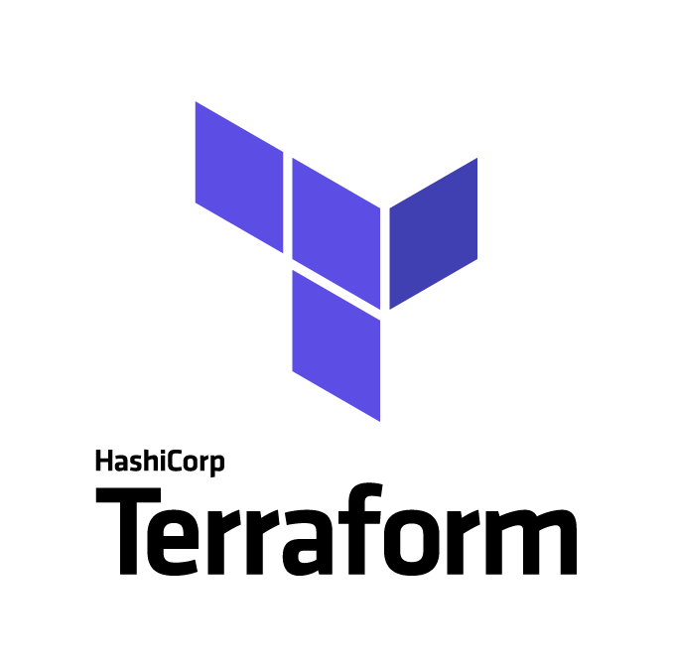
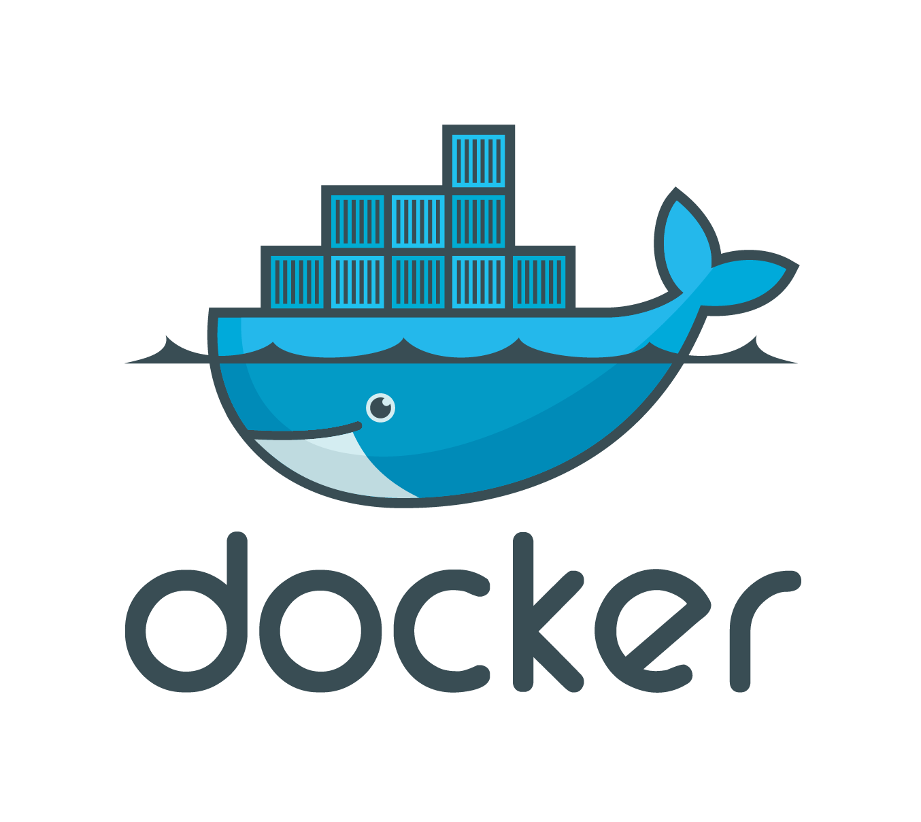
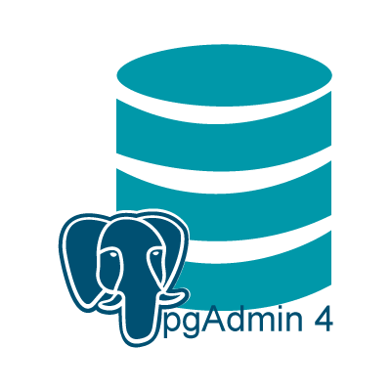
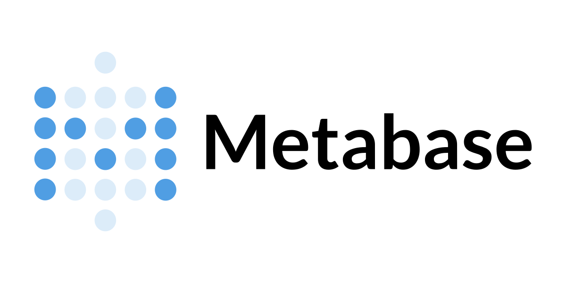

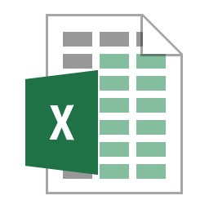





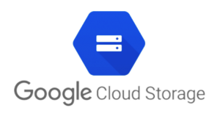

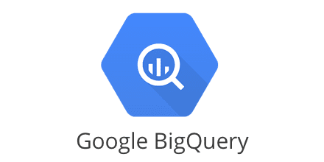

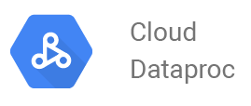
DATA ARCHITECTURE
Workflow Orchestration Tool
VM Instance or Local Computer
ALTERNATIVE A - LOCAL
LOCALHOST
INGEST DATA
DOCKER NETWORK
DATAFRAME
PARQUET
5432
80
DEVELOPMENT
DEPLOYMENT
VM Instance or Local Computer
TRANSFORMATION
LOCALHOST
LOCAL CLUSTER
5432
8080
WEBSCRAPING
INGEST DATA AND TRANSFORMATION
BATCH PROCESSING
JOBS
Data Lake
INGEST DATA AND TRANSFORMATION
VM Instance or Local Computer
LOCALHOST
INGEST DATA
JOBS
ALTERNATIVE B - CLOUD
DATAFRAME
PARQUET
Data Warehouse
TRANSFORMATION
LOCAL CLUSTER
DEVELOPMENT
INGEST DATA AND TRANSFORMATION
DEPLOYMENT
BATCH PROCESSING
JOBS
BATCH PROCESSING
Pipeline: | Bash Script Python Script Pyspark Script
 | Pyspark Script

Slide 2
DATA ARCHITECTURE
Workflow Orchestration Tool
VM Instance or Local Computer
Data Lake
LOCALHOST
VM Instance or Local Computer
LOCALHOST
WEBSCRAPING
INGEST DATA
DATAFRAME
PARQUET
Data Warehouse
TRANSFORMATION
ALTERNATIVE B - CLOUD
DEVELOPMENT
DEPLOYMENT
Pipeline: | Bash Script Python Script Pyspark Script

